Slide 1

COMBINATION INSULIN AND NON-INSULIN THERAPY TO ADDRESS MULTIPLE METABOLIC ABNORMALITIES IN TYPE 1 DIABETES (T1D)
Schafer Boeder, MD
Division of Endocrinology and Metabolism
University of California San Diego

Slide 2
A paucity of treatment options for T1D
Most people with T1D are unable to meet glycemic targets
Failure to address other metabolic abnormalities in T1D including:
  Insulin resistance
  Hyperinsulinemia (iatrogenic)
  Hyperketonemia / diabetic ketoacidosis (DKA)
  Increased risk of cardiovascular disease (CVD)

Slide 3
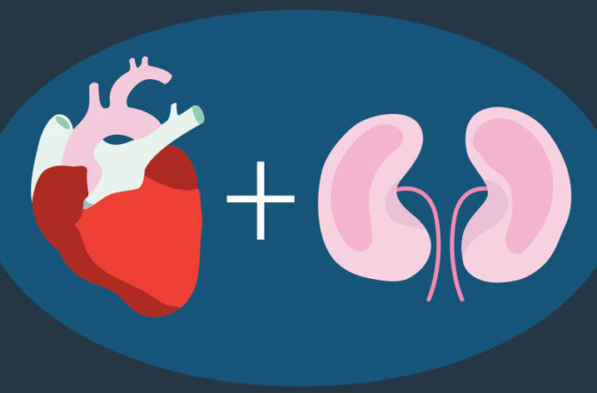

Glucagon Receptor Antagonist (GRA)
Sodium-Glucose Cotransporter-2 inhibitors (SGLT2i)
Improve glycemic control and reduce insulin use in T1D
Cardiovascular and renal benefits
Increase glucagon and DKA risk
Volagidemab (REMD-477) blocks effect of glucagon at the receptor
Improves glucose control, reduces insulin use, and may reduce ketogenesis

Slide 4
Study Aims
Evaluate the effects of combination adjunctive therapy using SGLT2i (dapagliflozin 10 mg daily) and GRA (volagidemab 70 mg weekly) on:
Glycemic control (CGM) and insulin use
Ketogenesis during an 8h Insulin Withdrawal Test (IWT)
Surrogate measures of cardiovascular disease

Slide 5
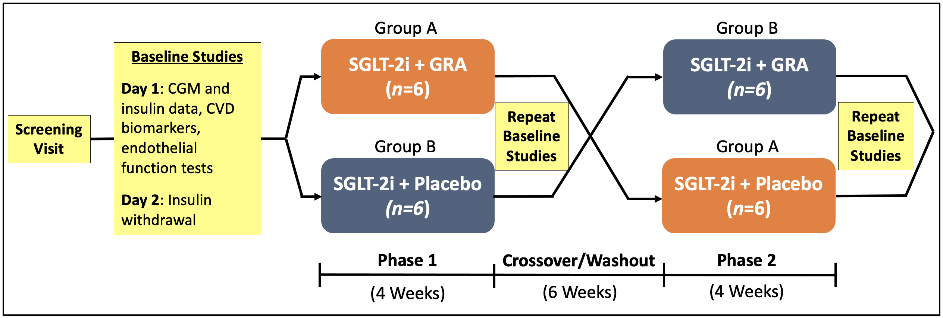
Study Design

Slide 6
REsults
AIM 1: Glycemic Control and Insulin Use

Slide 10
REsults
AIM 2: Insulin Withdrawal Test (IWT)

Slide 13
REsults
AIM 3: Markers of CVD

Slide 17
Summary
SGLT2i and combination SGLT2i + GRA can be used as adjunctive therapies to improve glycemic control in T1D
These treatments progressively reduce insulin dosing requirements and will mitigate hyperinsulinemia
Addition of GRA may improve the safety profile of the SGLT2i by reducing ketogenesis during insulinopenia
The CV effects of this combination are unclear

Slide 18
Next Steps
Manuscript preparation and submission
  Target: Diabetes Care
Secured funding
  JDRF Early Career Patient-Oriented Diabetes Research Award
Applied
  UCSD ACTRI KL2 Mentored Career Development Award
  NIH K23 Mentored Patient-Oriented Research Career Development Award

Slide 19
Support
Diabetes Research Connection Grant
UCSD-UCLA Diabetes Research Center Pilot and Feasibility Grant, NIH P30 DK063491
Altman Clinical and Translational Research Institute Pilot Project Award, University of California San Diego, NIH UL1TR001442

Slide 20


